Slide 1
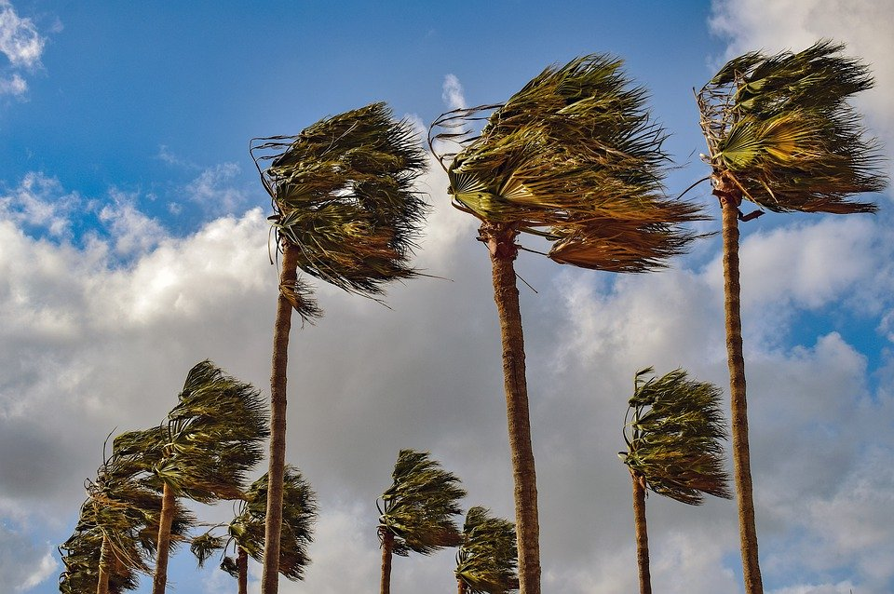
Wind Energy
By Evan, Jon, Candace

Slide 2
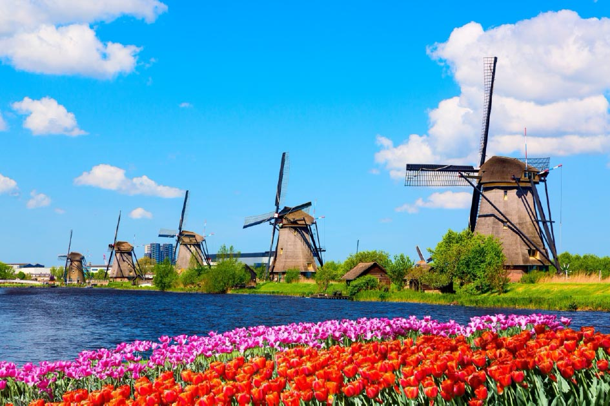
Ancient Wind Turbines
These were early windmills
They made energy
Usually to power something
Not very complex
Super inefficient

Slide 3
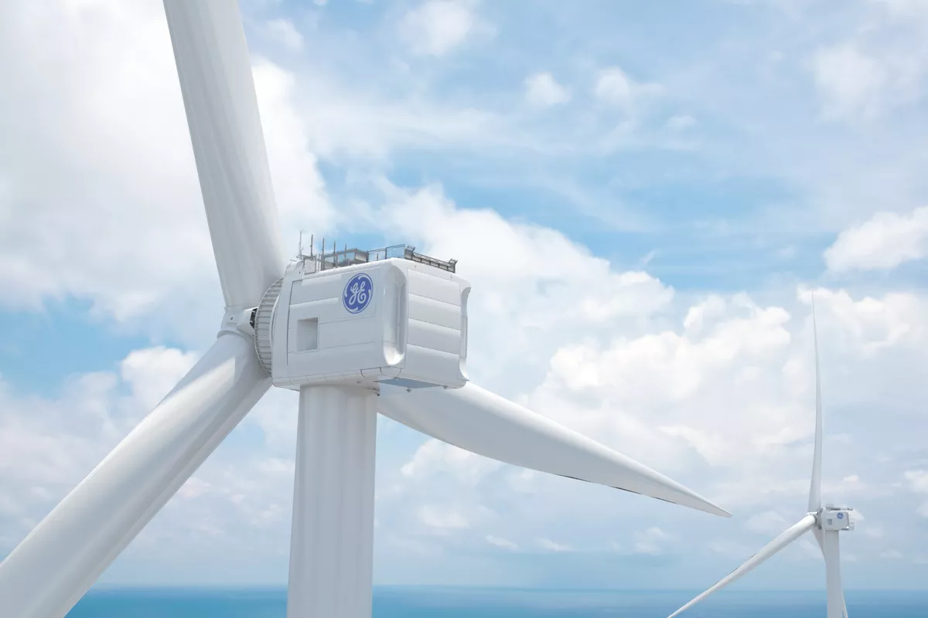
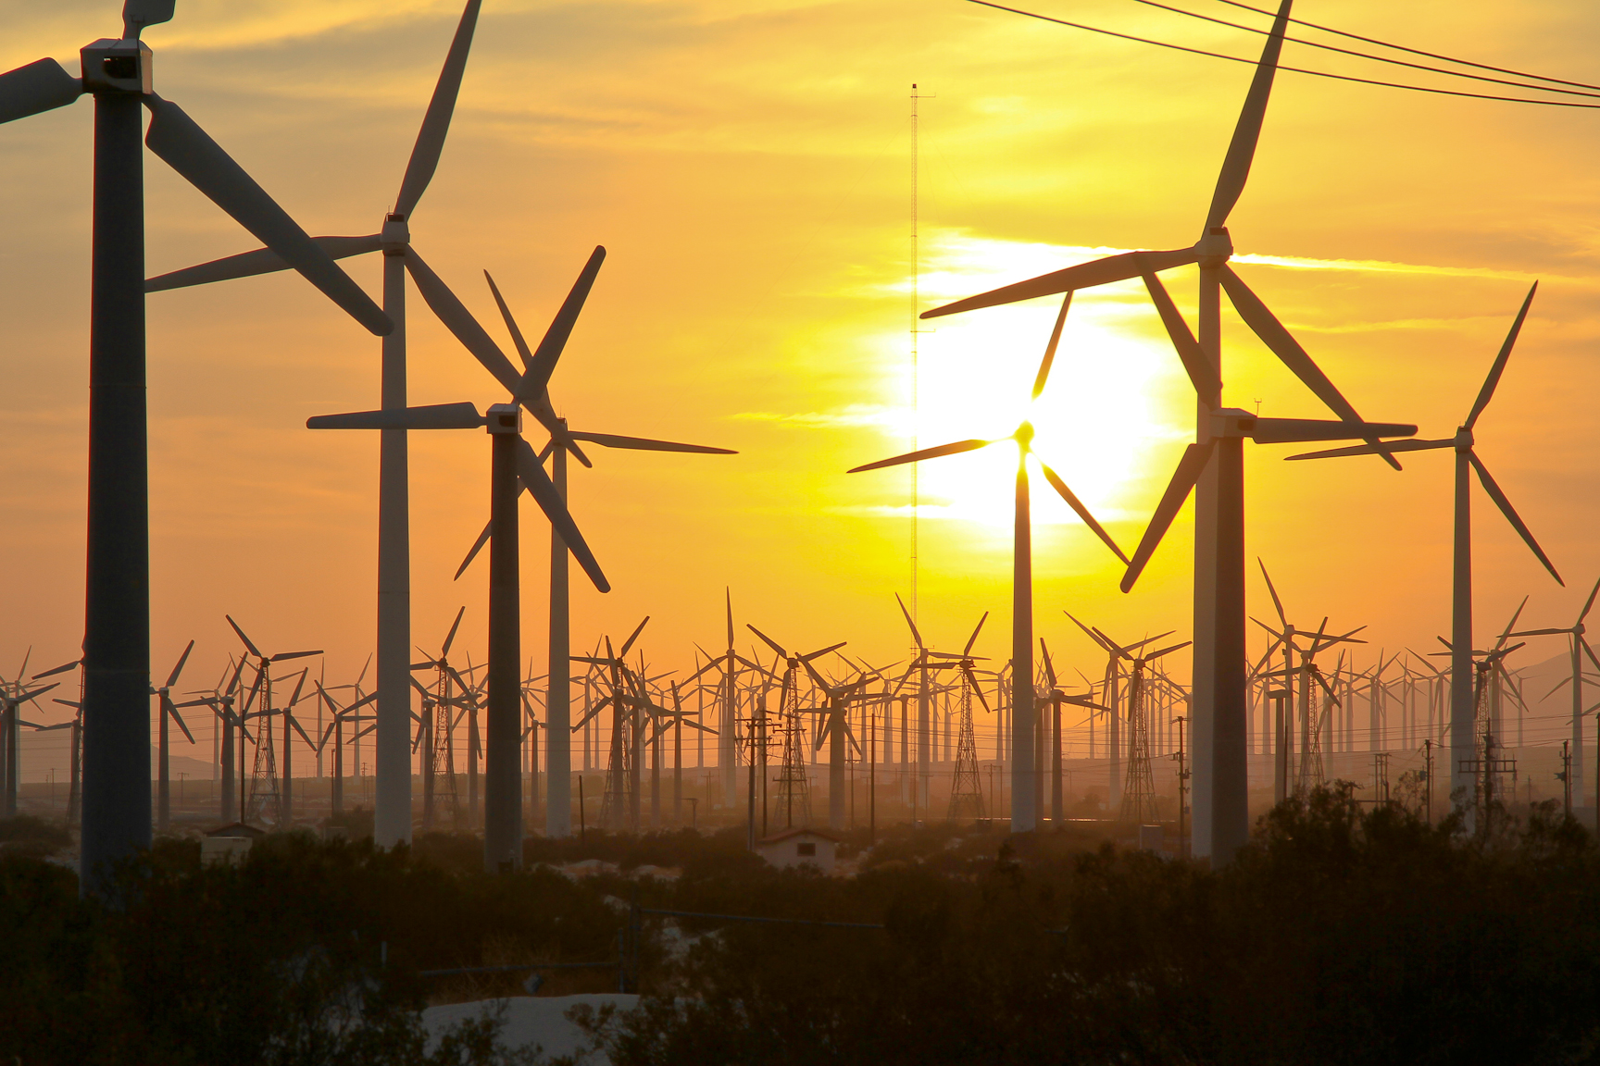
Modern Wind Turbines
Is generally long (>30m). Can generate up to a few MW per hour.

Slide 4
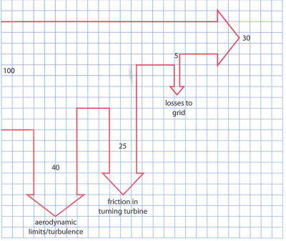
Conditions
Optimal speed is between Sankey Diagram
6 ms⁻¹ to 14 ms⁻¹
Strong winds affect the wind turbines
Cause stress or damage
Efficiency 30%
40% lost to turbulence
25% friction in the turbine
5% lost to grid

Slide 5
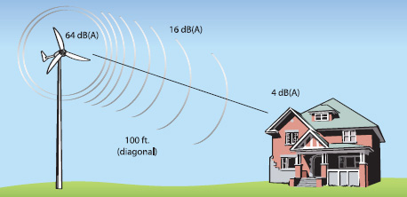
Advantages and Disadvantages
Advantages | Disadvantages
Free | Dependent on local wind conditions
inexhaustible | Aesthetic problems
Clean | Noise problems

Slide 6
MATH
Finding Kinetic Energy
P = (1/2)( ρA)(v³)
Density of air Velocity (wind speed)
Area of blade
Doubling Area doubles power extract

Slide 7
Video ideas
https://www.youtube.com/watch?v=79aARWPalt4
https://www.youtube.com/watch?v=qx_M0nvDIGU
https://www.youtube.com/watch?v=qSWm_nprfqE

